Slide 1
College Connect
Demo
Thomas Benfield (HTML/CSS dev), Jonathan Feurtado, Afif Mujibur-Rahman (developer/tester), Zachary Tissue(Design/Review), Julian Franzen (Database dev)

Slide 2

What is College Connect?
Small-scale social media application designed for a local college community.
Allows for students within a college community to connect with their peers in a safe and partitioned-off online environment
  Exclusively for college students, faculty, and staff
College connect hosts a forum where students can discuss a variety of topics among their peers.
College Connect also features a roommate finder application that will allow students to find their best potential roommates based on their requested criteria.

Slide 3
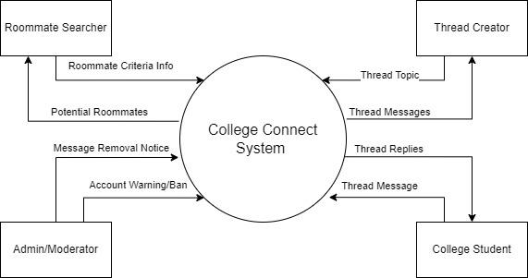
Context Diagram

Slide 4
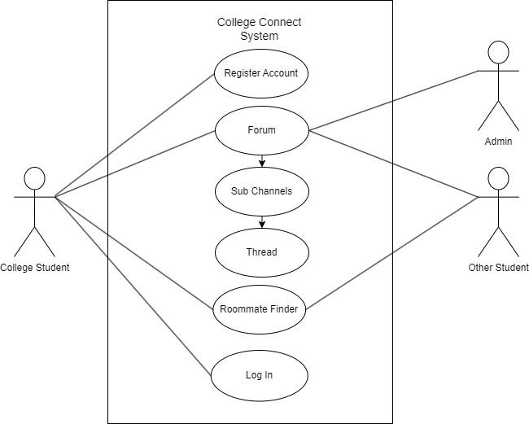
Use Case Diagram

Slide 5
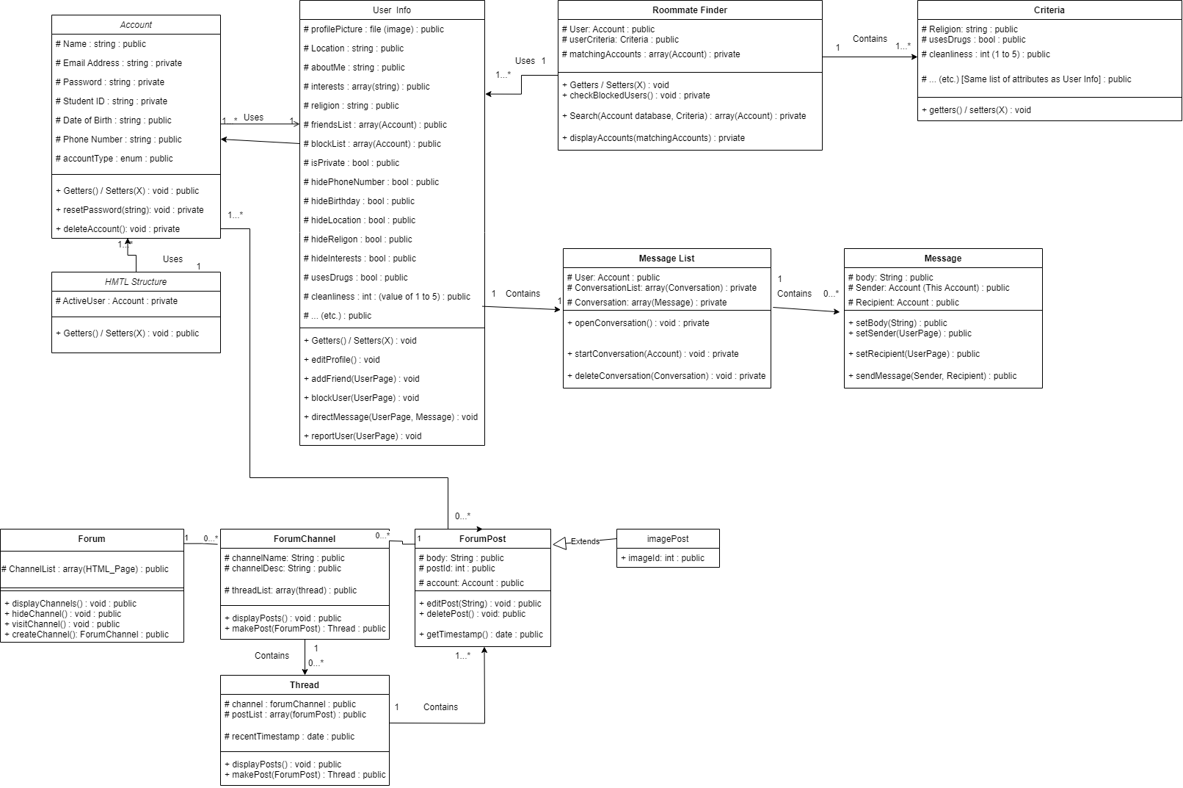
Class
Diagram

Slide 6
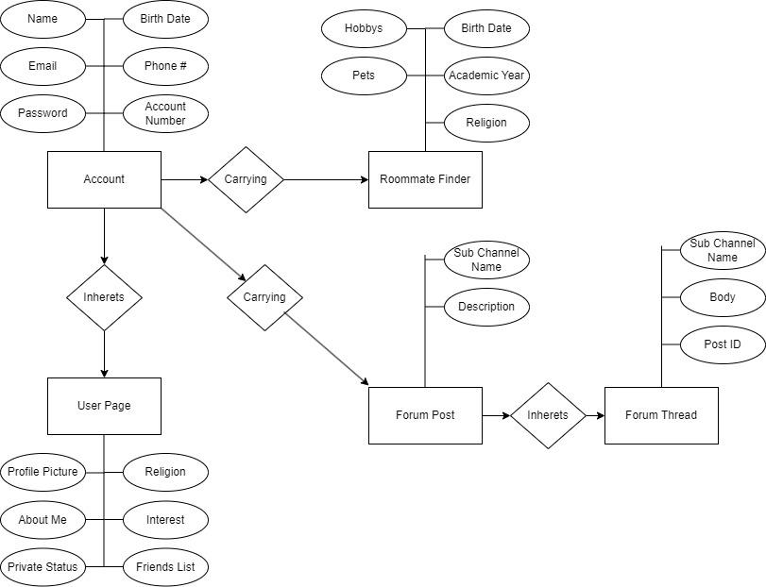
Other UML Diagrams

Slide 7
Current Features
User Sign-Up and Login
Profile Page Customization
Users can grant themselves Personality Tags
Roommate Finder application
Forum

Slide 8
Sign-Up / Log-In
Users who do not have an account may sign -up through the sign-up page
Signing up creates a new account object with the in the database and stores the user’s credentials
  All account information is stored, so all data associated with that account should persist between sessions.
If the user has an account, they may enter the correct credentials to log into that account.
User can also log out once they log in

Slide 9
Profile Page and Personality Tags
Profile Page displays user information based on the contents of the user’s database
Personality tags/attributes describe a user’s personality and characteristics
  I.e How much does cleanliness mean to you (1 to 5), do you do recreational drugs (y/n), are you a morning bird or night owl, etc.
Personality tags can be added or edited from the “Edit Profile” button
User can write an “About Me” blurb to describe themselves

Slide 10
Roommate Finder
Students can find potential roommates through this feature.
Categorized based on the attributes and personality values input on their Profile Page
Students submit a set of criteria and students that match the criteria will appear in search results
  Age, Gender, Grade, Religion, Neatness, Drug usage, Chronotype
Search results will be displayed in order based on students with the most matched criteria

Slide 11
Forum
The forum will allow students to communicate with each other in a standard web-forum layout.
The forum will be separated into channels and sub-channels, based on general topics (i.e School: Computer Science, Math, etc., Entertainment: Movies, Video Games, TV, etc.)
Students will be able to make a individual thread under the topics of these channels to discuss particular subjects amongst each other.
More active threads (threads with recent messages) should be shown at the top of the thread list, while less active threads show below.

Slide 12
Main User Stories
I am a college student who is moving into dorms for a new semester, and I’m not comfortable with the idea of rooming with a stranger I don’t know. I would like to have a way to find a potential roommate I would get along with before settling my housing situation.
I am a student arriving on campus for the first time. I would like to connect with other students and communicate with them to make new friends or social connections. Being able to send messages on an open forum would be nice as I could meet many new people while connecting with those who have similar interests.
I’m a college student who’s very religious and looking for a roommate who shares the same beliefs to maintain a peaceful environment. I’m looking for a roommate who doesn’t have any drinking/smoking habits and keeps a clean and family-friendly environment for whenever my family visits.

Slide 13
Demo Video

